Slide 1
Back to School 2020-2021
Ms. Jones, School Social Worker

Slide 2
Meet Ms. Jones...
https://youtu.be/3yG3CgZcvcc

Slide 3
Welcome to the 2020-2021 School Year at OHS!
This year may look very different since we are virtual. However, the same supports are available as if we were in the actual school building...You just have to know where and how to find them. Hopefully, I can help you with that.

Slide 4
Overall Support
In my role as an Orange High School Social Worker, my goal is to support the mission of the school :
“to promote the academic, social, emotional and personal success of all students.”

Slide 5
Social Worker Responsibilities
Some of my specific responsibilities:
Group and individual counseling
Anti-bullying Specialist
Intervention and Referral Services
504 Coordinator
Staff development and support

Slide 6
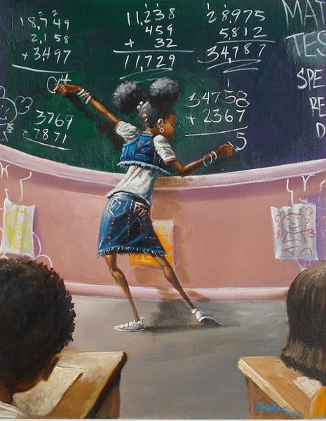
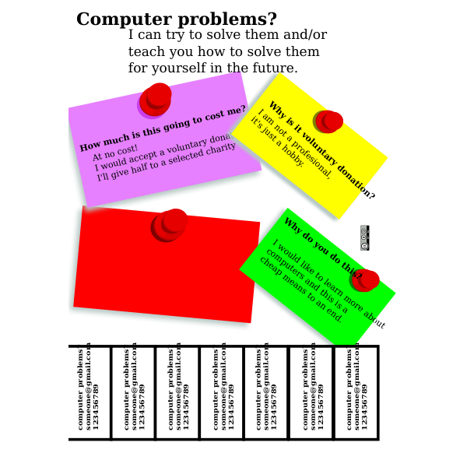
Ms. Jones Virtual Office
Let’s talk about coping skills...

Slide 7
Counseling Services
Individual
Students come to school with a number of issues and concerns. Those issues can range from a general feeling of sadness to thoughts of suicide. Students have relationship concerns. Some of them are supporting their families or have children of their own. Some students are frequently tardy or absent from school or may be trying to overcome health or substance abuse challenges.
Group
Mr. Wallace (OHS School Social Worker) and I set up groups according to the needs of our students. Past groups have included:
“Keep Calm” group for anger management
The Breakfast Club LGBTQ group
Parenting Teens group
Grief Group
Ladies in Training group

Slide 8
Harassment, Intimidation and Bullying (HIB)
The NJ HIB law was designed to assist students who feel harassed, intimidated or bullied in school. The law covers incidents that happen either in school or off school grounds. It can be one incident or many. As the School Anti Bullying Specialist, I investigate reported incidents within 10 days. Once an incident is determined to be substantiated or not, parents are informed and the a report is sent to the Orange Board of Education.

Slide 9
I&RS
(Intervention and Referral Services)
Intervention and Referral Services is a process whereby students who are struggling academically, emotionally or behaviorally receive support. The support is designed to assist both the teacher and student. The I&RS has different staff members along with the parent who discuss strategies to help a student be more successful in the school environment. Students are referred by either a staff member or a parent. The process takes a minimum of 6 weeks. There is an initial meeting to gather information and share ideas. An action plan is then developed and the issue is revisited 6 weeks later. During the second meeting, the plan is either considered to be successful or it is extended/revised. Mr. Wallace and I co-chair the I&RS process.

Slide 10
504 Plan
A 504 plan supports students who have a disability that impacts their daily activity- such as, learning. A 504 plan protects students from discrimination and provides them with modifications and/or accommodations to support their success. A 504 plan is not special education. It falls under general education. As, the 504 coordinator at OHS, when a student is in need of a 504 plan, I am responsible to ensure that it gets developed and implemented.

Slide 11
Staff and Parent Support
I am available to help with all types of issues and concerns. I provide referrals and facilitate conflict resolution I am available to share resources and troubleshoot problems that may stand in the way of student success. I am always willing to go above and beyond to assist.

Slide 12
Contact Info
Email:
Jonesdan@orange.k12.nj.us
Remind: @c67ba8
Office: 973-677-4050 x5020
*We can also set up a Google meet or Zoom…*

Slide 13
Thank you for taking time to view my presentation! I look forward to working with you this year!
Ms. Jones

